Slide 1

Terminology translation accuracy in SMT vs. NMT
Špela Vintar, Dept. of Translation Studies, University of Ljubljana
spela.vintar@ff.uni-lj.si , http://www.lojze.si/spela

Slide 2
Our aims
Compare the quality of Google’s NMT vs. PBMT for English-Slovene and Slovene-English
Domain-specific texts: Karstology Corpus
Special focus on terminology translation
  automatic evaluation using an existing termbase
  human evaluation by domain expert

Slide 3
Why terminology matters
Professional translators spend up to 45% of their total working time researching terminology
Terminology errors amount to over 70% of errors found in QA
Guidelines for post-editors emphasize terminology consistency as one of the main problems of industry-used MT systems
Notes:
In professional translation environments, terminology research takes up to 45% of the total working time spent on translating a text, and according to a recent study by SDL terminology errors amount to over 70% of all errors found in the Quality Assurance (QA) process. Post-editing guidelines developed by organisations such as TAUS or SDL suggest that post-editors should pay particular attention to the consistency of terminology, because nearly all state-of-the-art MT systems still produce translations on a segment-by-segment basis and thus choose terms according to local contexts instead of entire texts.
http://www.sdl.com/download/the-importance-of-terminology-management/71096/
https://www.taus.net/knowledgebase/index.php?title=Category:Post-edit
http://www.sdl.com/download/introduction-to-machine-translation-and-postediting-paradigm-shift/58317/

Slide 4
The Karst Corpus & the Karst Termbase
15 abstracts and 5 articles from 2 scientific journals, Acta Geographica and Acta Carstologica Slovenica, fully bilingual
Total size: 25,423 English, 18,985 Slovene
All texts translated twice using Google’s PBMT and NMT models (via GT API)
QUIKK termbase: karst landforms and processes, 81 fully populated concepts
Google Translate is a general purpose MT system, so why test it on a domain-specific text?
  Karstology – at least for English-Slovene – is not as exotic as it may sound
  Lots of parallel data in both directions
  In many professional environments, on-the-fly domain adaptation is still not feasible

Slide 5
Evaluation methods
Automatic overall MT evaluation
  document-level BLEU and NIST
Automatic evaluation of term translations
  linguistic pre-processing
  matching terms & equivalents from the QUIKK termbase
Human evaluation of term translations
  300 random term occurrences (both systems & both directions)
  manual evaluation by domain-expert using three categories:
    Correct: The system uses the right term equivalent, regardless of grammar errors.
    False: The system does not use the right equivalent. Partially correct multi-word term was considered wrong.
    Omitted: Original term skipped in translation.

Slide 6
Automatic evaluation
English-Slovene |  |  |  | Slovene-English
PBMT |  | NMT |  | PBMT |  | NMT
BLEU | NIST | BLEU | NIST | BLEU | NIST | BLEU | NIST
18.50 | 3.59 | 22.49 | 3.85 | 22.53 | 4.24 | 25.43 | 4.35

Slide 7
Terms and equivalents matching the termbase
For each source term found in the original we check whether the translation contains the equivalent
Normalisation on both sides
 | English-Slovene |  | Slovene-English
 | PBMT | NMT | PBMT | NMT
Terms in original | 538 | 538 | 680 | 680
Terms in translation | 420 | 431 | 476 | 446

Slide 8
Human evaluation of term translations
500 random occurences for each system and language pair were checked by a domain expert
Categories:
  Correct (even if the case and number were wrong)
  False (even if one part of a multi-word term was correct, or if the system used the correct expression but not for the domain)
  Omitted
 | English-Slovene |  |  |  | Slovene-English
 | PBMT | % | NMT | % | PBMT | % | NMT | %
Correct | 184 | 61.3 | 211 | 70.3 | 201 | 67 | 195 | 65
False | 113 | 37.7 | 85 | 28.3 | 94 | 31.3 | 99 | 33
Omitted | 3 | 1 | 4 | 1.3 | 5 | 1.7 | 6 | 2

Slide 9
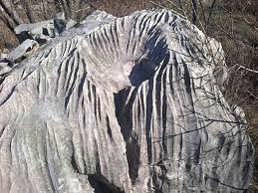
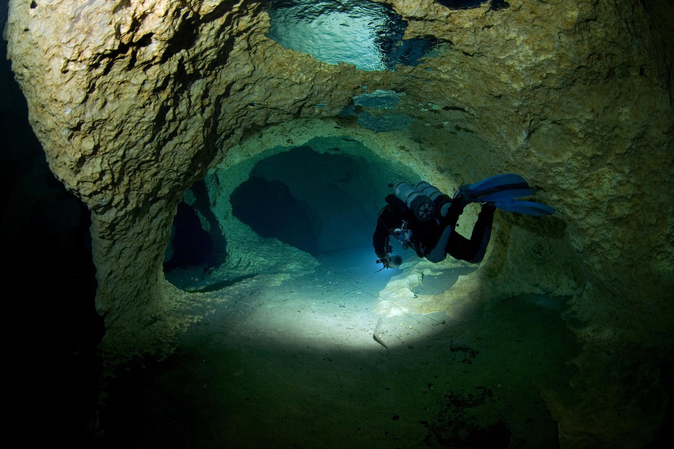
A glance at errors
En-Sl
  PBMT:
    untranslated term / term component
    epigenic aquifer → epigenic vodonosnik
    solution runnel → raztopina runnel
    wrong sense
    spring → vzmet
    Mlava Spring → Mlava pomlad
  NMT:
    out-of-the-blue translations
    cave diving → jalovo potapljanje
    coined words
    ajerno, nekarska, glacijacija

Slide 10
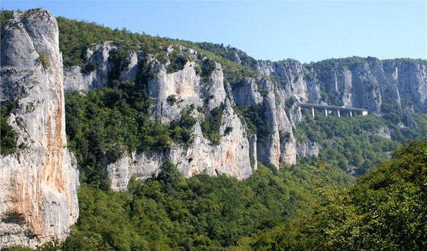
A glance at errors
Sl-En
  PBMT:
    untranslated term / term component
    nepaleokraške kamnine→ nepaleokraške rocks
    grammatical but non-terminological translation
    brezstropa jama → roofless cave (denuded cave)
    udornica → hollow / precipice / collapsed / sinkhole (collapse doline)
  NMT:
    out-of-the-blue translations
    vrtača → crop rotation (sinkhole)
    zakraselost → naivety (karstification)
    melioracija → reclamation (melioration)
    unsuccessful attempts at proper names
    inconsistencies:
    udornica → collapse / udder / cliff / collision / burrow / groove

Slide 11
Conclusions
Measured with BLEU/NIST, Google’s NMT outperforms PBMT for En-Sl and Sl-En
Translations of domain-specific terminology are not significantly improved in NMT
On-the-fly domain adaptation may not be available in many end-user environments
Need for post-processing methods

